Slide 1
Part 1
Part 2
Part 3
Part 4
Part 5
R Project
武岳 王嘉雪 谭致恒
ANOVA
变量选择
聚类分析
回归
应用分析
“All models are wrong, but some are useful. ”
---- George Box

Slide 2
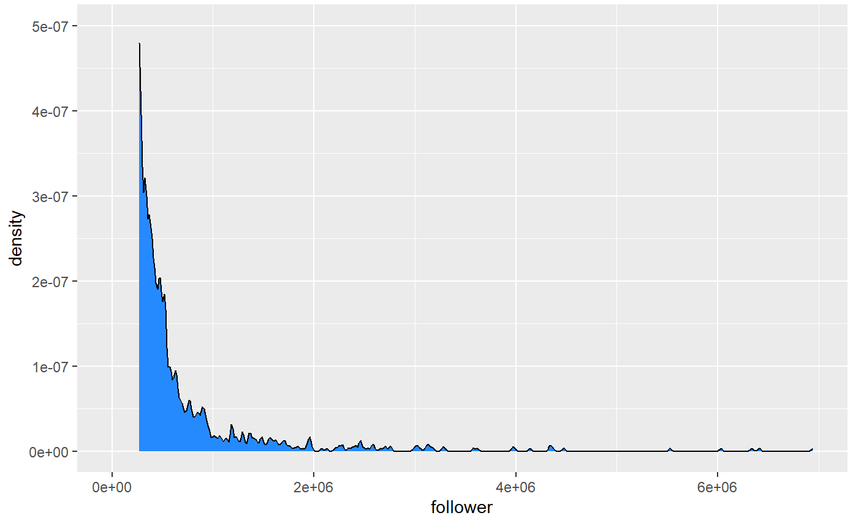
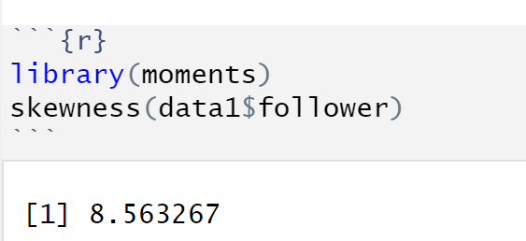
回归
Follower: nonnegative integer
count data
View it as a continuous variable and take log then fit a multiple linear regression;
Fit a poisson model or negative binomial model;

Slide 3
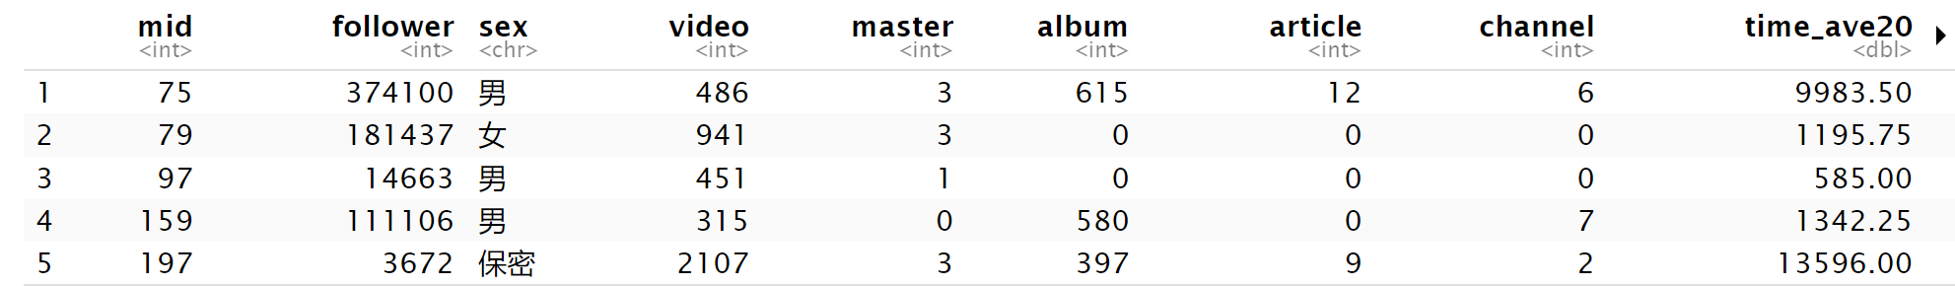
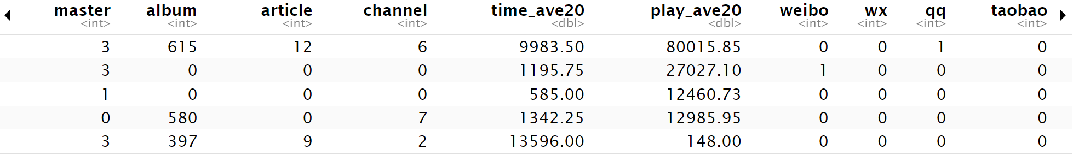
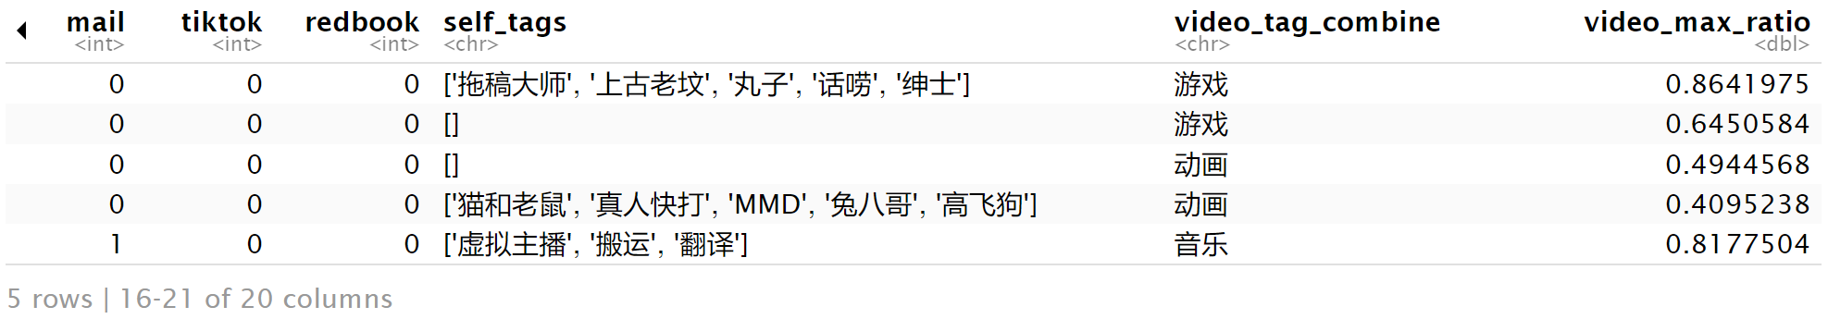
多元线性回归
Data preparing:
离散变量设为factor; self_tags 转变为0，1类别变量; 综合与第三方平台关联信息 num_platforms;
Log transformation

Slide 4
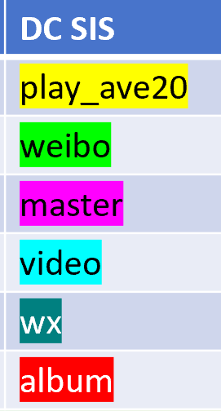
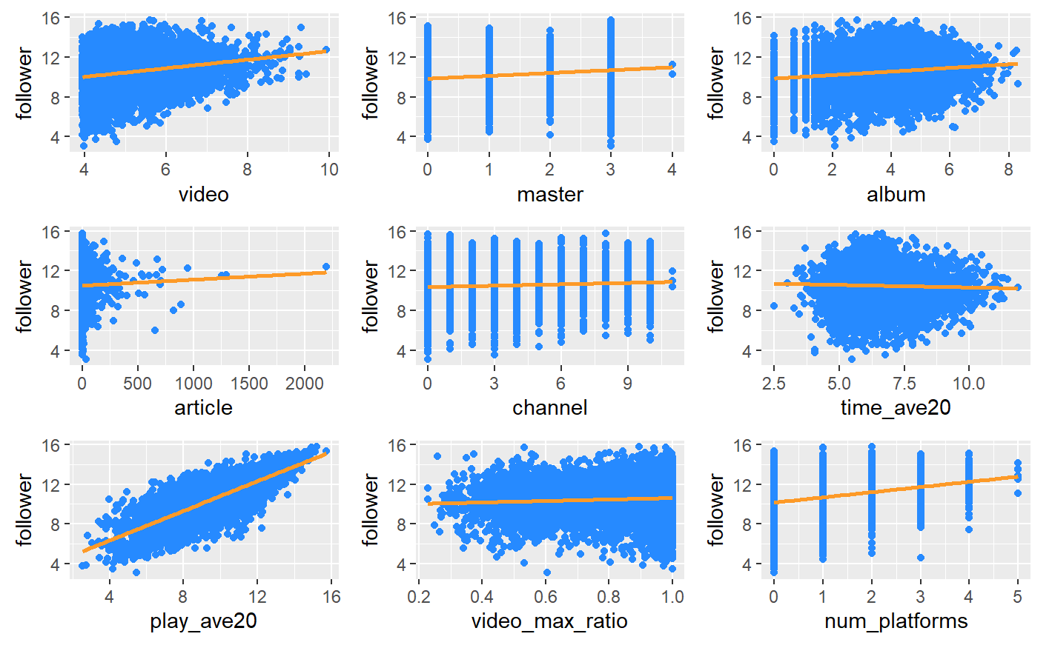

Slide 5
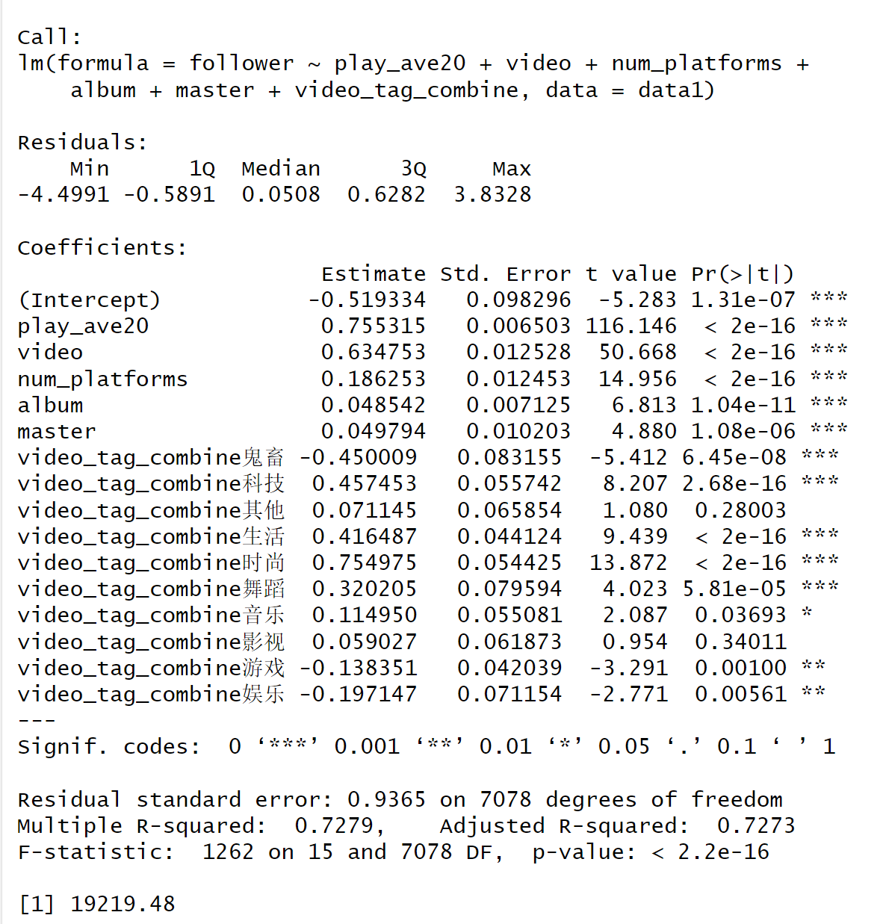
F statistic is significant, so the model is useful;

Slide 6
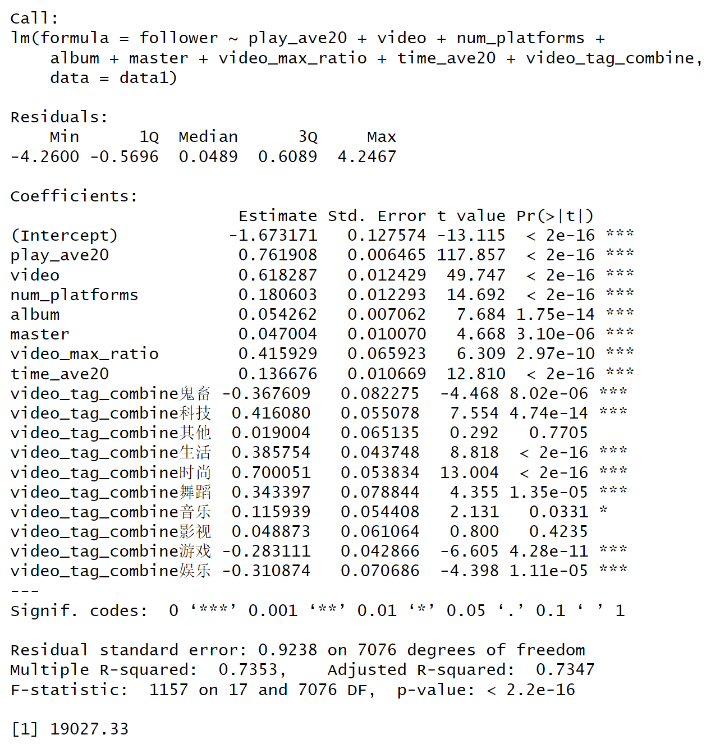

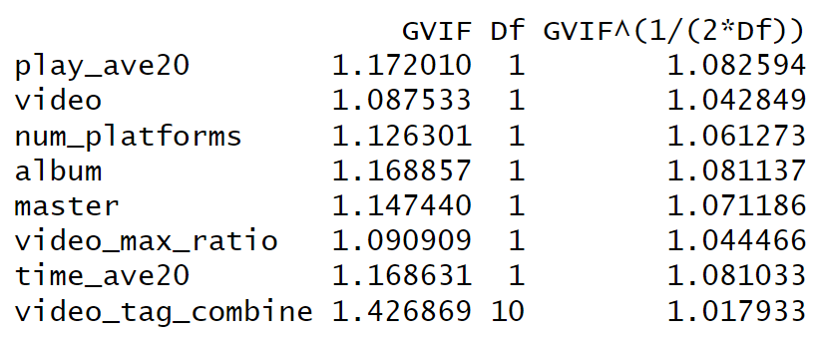
Step(BIC)： 新增
time_ave20, video_max_ratio

Slide 7
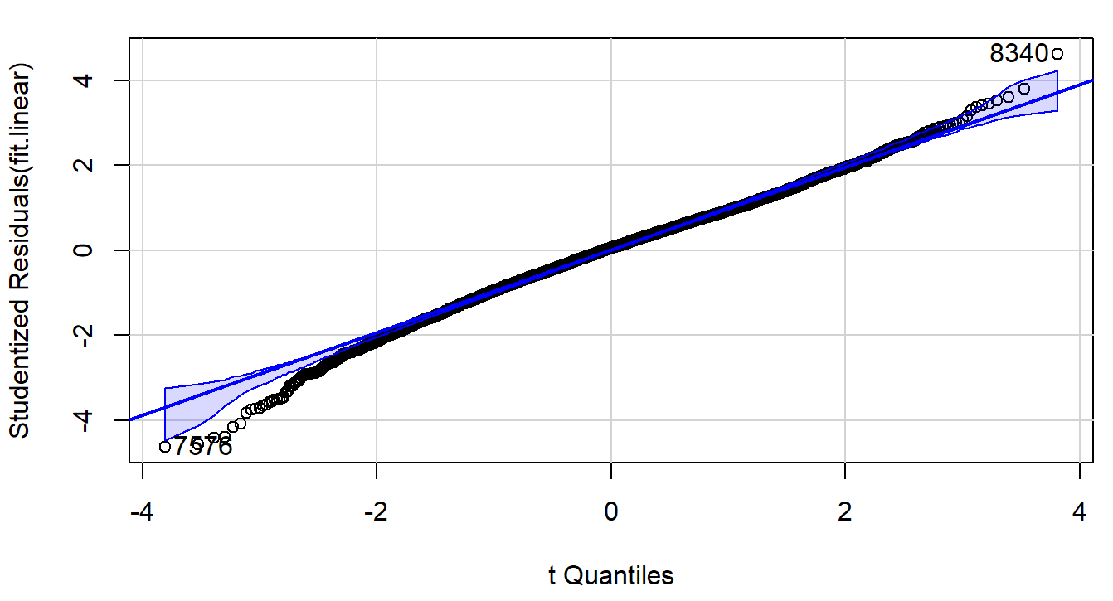
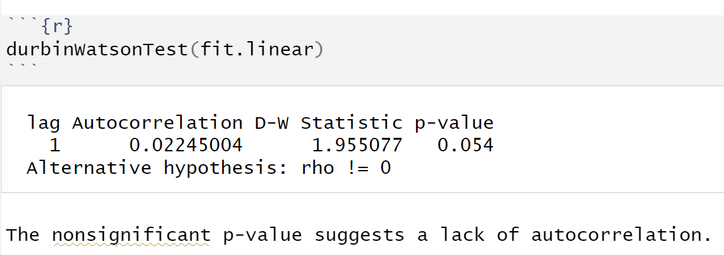
Validate the assumptions
Normality
Independence

Slide 8
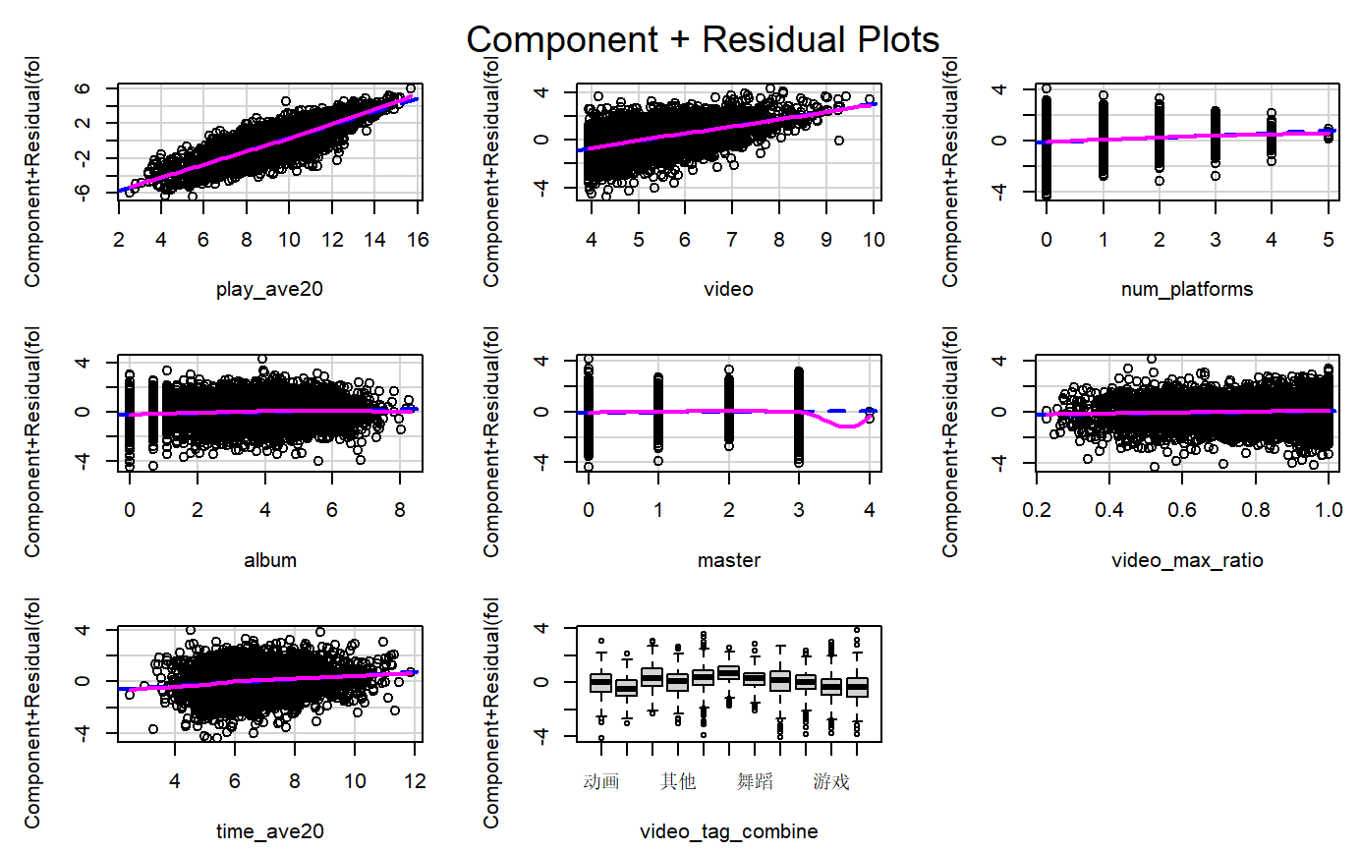
Linearity

Slide 9
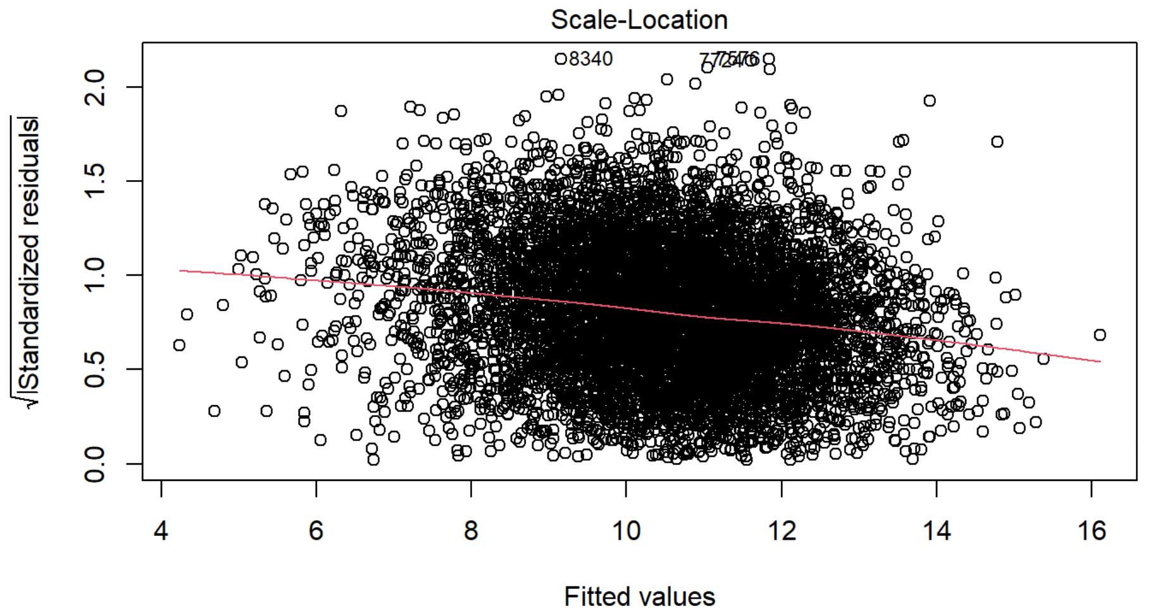
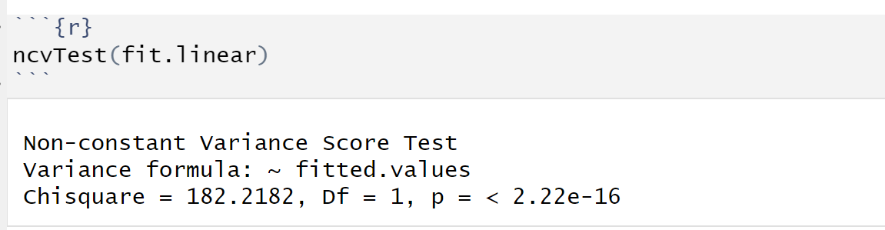
If you’ve met the constant variance assumption, the points in the Scale-
Location graph (bottom left) should be a random band around a horizontal line.
Non constant variance

Slide 10
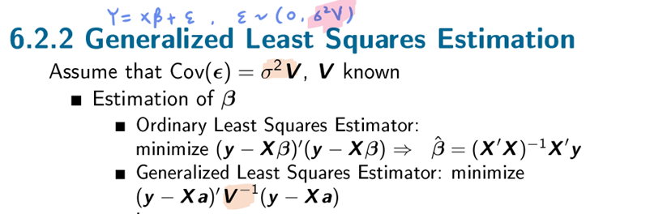
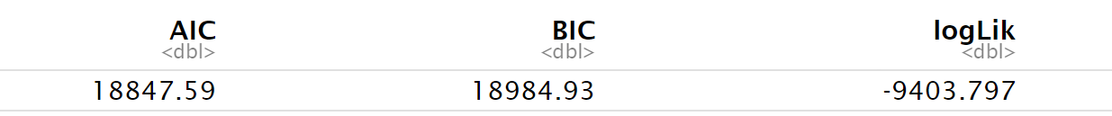
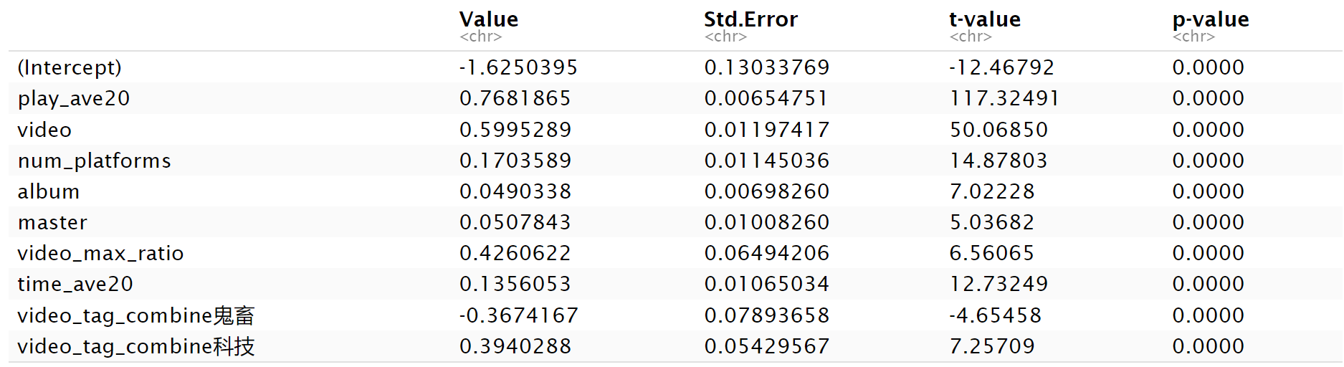
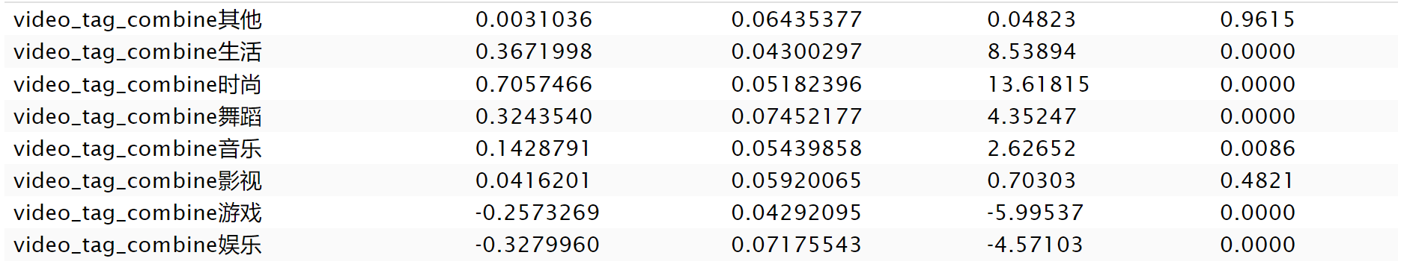
广义最小二乘法（Generalized Least Squares, GLS）

Slide 11
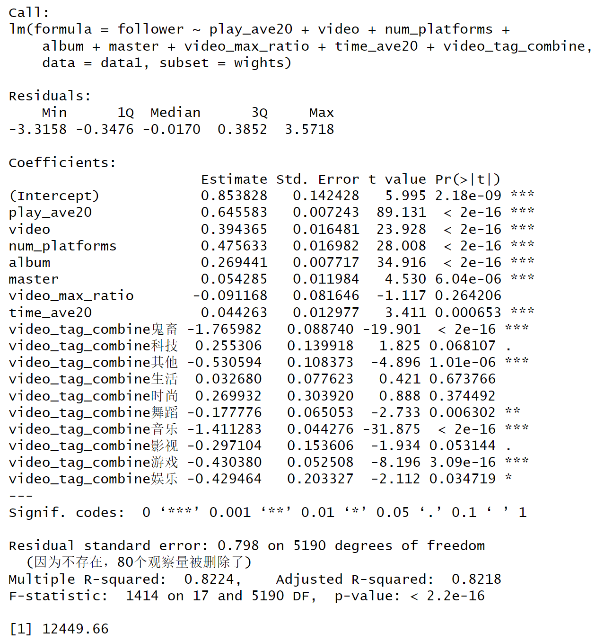
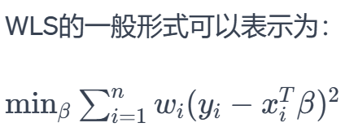
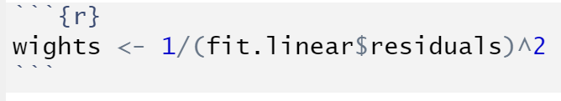
加权最小二乘法（Weighted Least Squares, WLS）

Slide 12
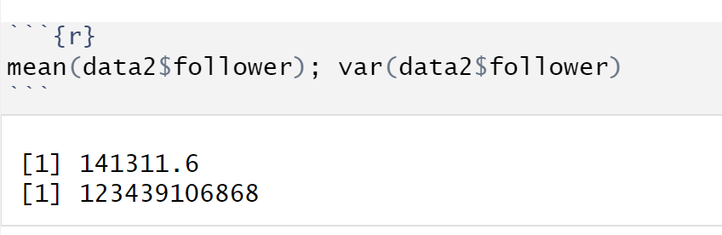
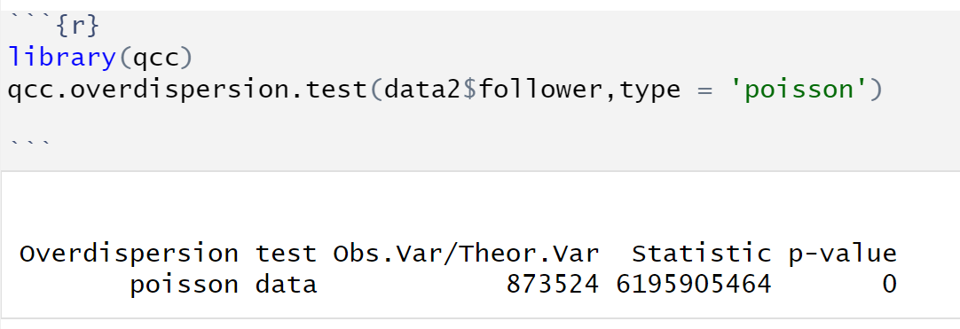
广义线性模型
Possion regression assumes the mean equals to the variance

Slide 13
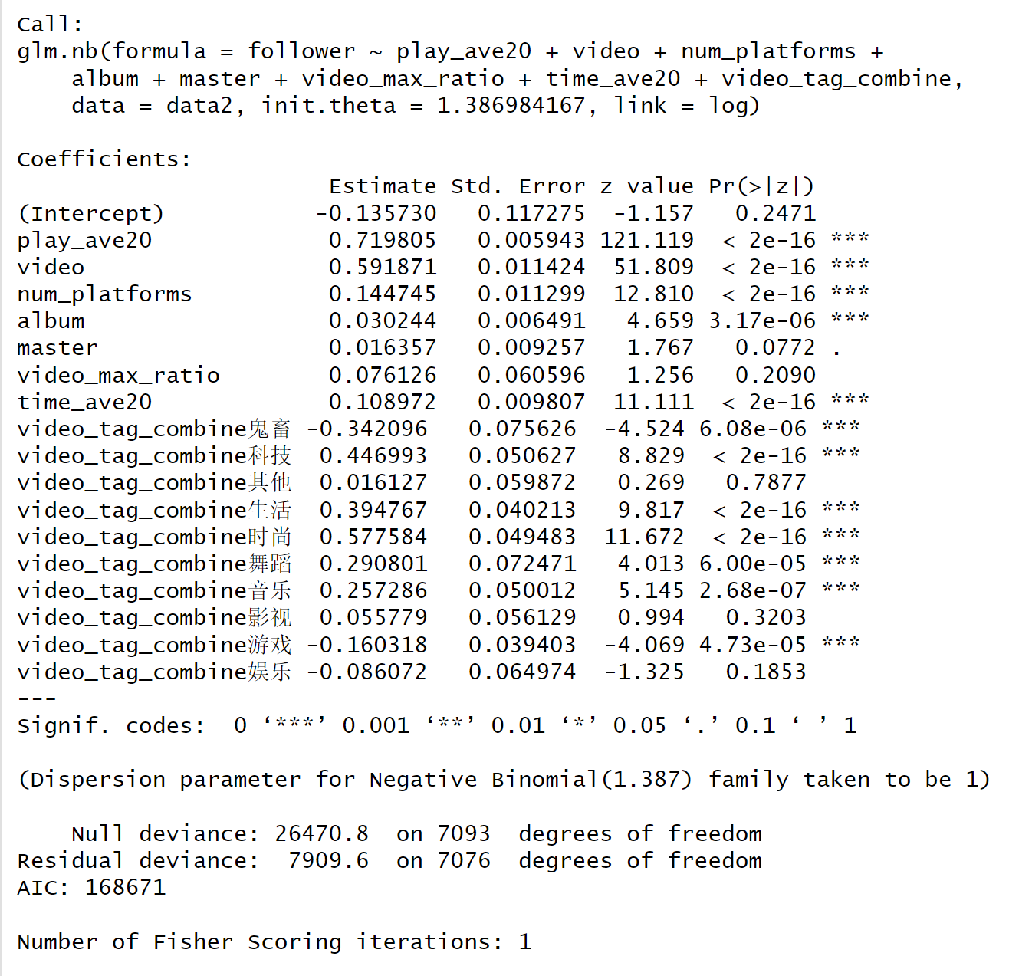

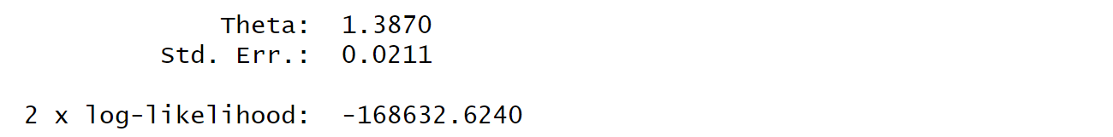
负二项回归
Mean = u;
Variance =

Slide 14


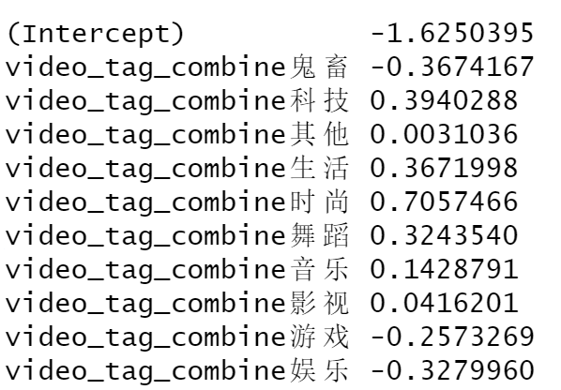


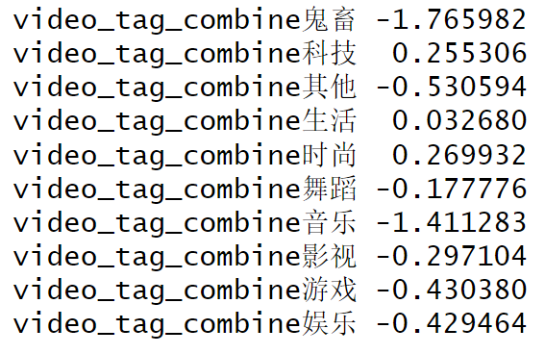
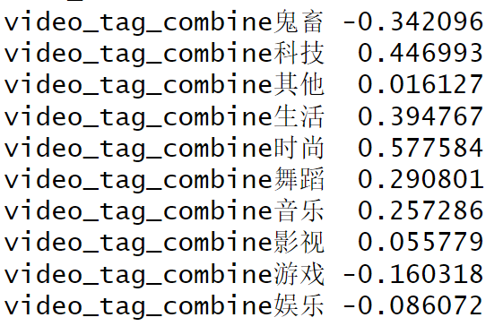
模型解释
GLS
WLS
NB
播放量增大100：
播放量增大1000：

